Slide 1



Car Price Analysis & Prediction Using PowerBI
Gayathri G
Reona P
Ashmithaa P
August 2025
15-01-2026

Slide 2


Objective
To analyze car prices using historical vehicle data and create an interactive Power BI dashboard for insights and prediction support.

Slide 3
Number of Records: 2000
Key Columns:
Car ID
Brand
Model
Year
Engine Size
Fuel Type
Transmission
Mileage
Condition
Price
Dataset Overview
This dataset contains information about different cars including pricing, specifications, and usage details.

Slide 4

Steps Performed
Removed duplicate values
Checked & handled missing values
Converted data types:
Year → Whole Number
Price → Decimal Number
Mileage → Whole Number
Standardized text fields:
Fuel Type (Petrol, Diesel, Electric, Hybrid)
Transmission (Manual, Automatic)
Renamed columns for clarity
Created a New Column for Price Category(Low, Medium ,High)
Data Cleaning & Transformation (Power Query)

Slide 5


Data Preparation Outcome
Clean & consistent dataset
No null or duplicate records
Correct relationships between columns
Dataset ready for DAX calculations & visualization

Slide 6

DAX Measures Created
Total Revenue = SUM('car_price_prediction_'[Price])
Total Cars = COUNT('car_price_prediction_'[Car ID])
Unique Brands = DISTINCTCOUNT(car_price_prediction_[Brand])
Car Age = YEAR(TODAY()) - car_price_prediction_[Year]
Average Price = AVERAGE('car_price_prediction_'[Price])

Slide 7

Key Metrics (KPIs)
Total Cars: 3K
Total Revenue: 131.60M
Unique Brands: 7
Average Price: 52.64K
Average Mileage: 149.75K

Slide 8
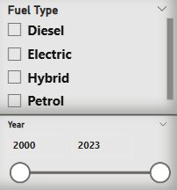
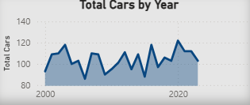
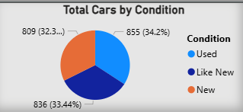
Dashboard Overview
Bar Charts – Price by Brand, Fuel Type
Line Charts – Price Trend by Year
Pie / Donut Charts – Condition & Transmission
Cards – KPIs
Tables – Detailed brand & model data
Slicers – Brand, Year, Fuel Type, Transmission

Slide 9
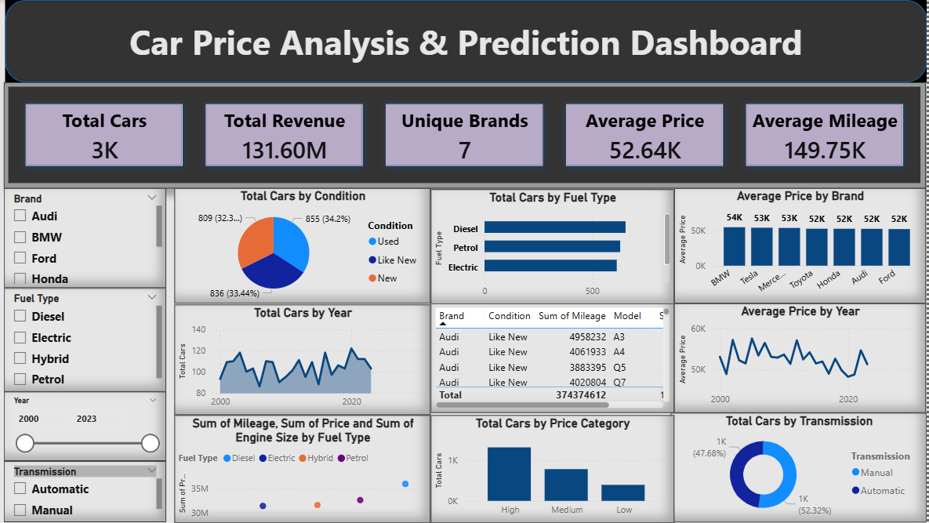

Slide 10
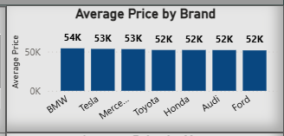
Key Insights – Pricing
BMW & Tesla have the highest average prices
Older vehicles show lower average prices
Price fluctuates but shows stable long-term trend
High price category has the maximum number of cars

Slide 11
Key Insights – Fuel & Condition
Petrol vehicles dominate the dataset
Electric cars have higher average prices
Majority cars are Like New & Used
New cars contribute less in count but higher price

Slide 12
Recommendations
Focus on Electric & Automatic vehicles for higher revenue
Pricing strategy should consider mileage impact
Promote premium brands for profitability
Use dashboard for real-time filtering & decisions

Slide 13
Conclusion
Power BI enables powerful data storytelling
Clean data + DAX = meaningful insights
Dashboard provides interactive & dynamic analysis
Project successfully meets analysis objectives

Slide 14
Thank You

